Slide 1
Efficient 3-D Near-Field MIMO-SAR Imaging for Irregular Scanning Geometries
Josiah W. Smith
Murat Torlak

Slide 2
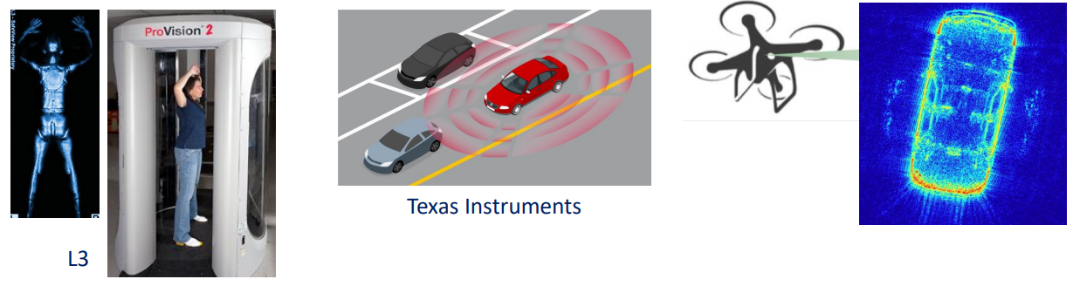
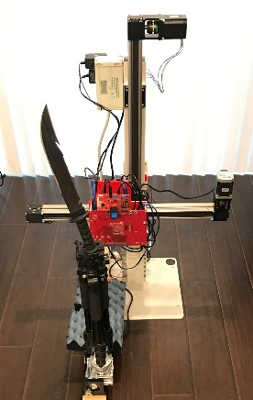

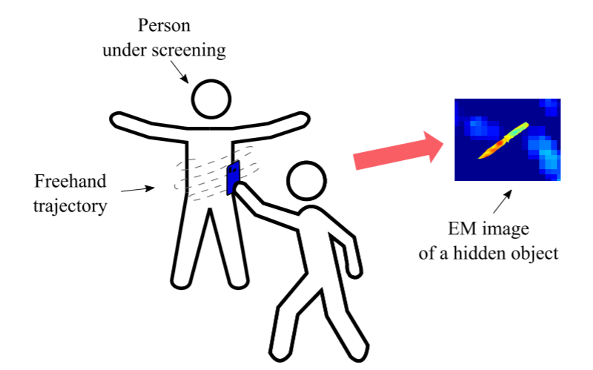


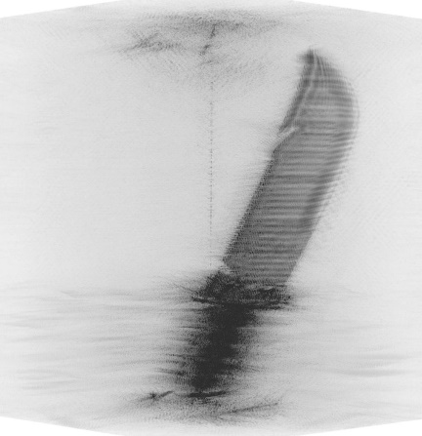
Background
Conventional array imaging techniques require highly controlled positioning
Emerging applications require relaxing this constraint
Smart-phone mmWave scanning
Automotive / UAV SAR
Challenge: Efficient algorithm for image recovery given irregular scanning geometry
Traditional Array Imaging: Controlled Scanning Pattern
Emerging Applications: Irregular Scanning Geometries

Slide 3
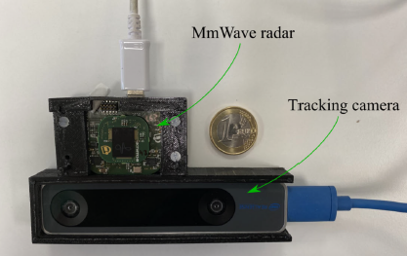
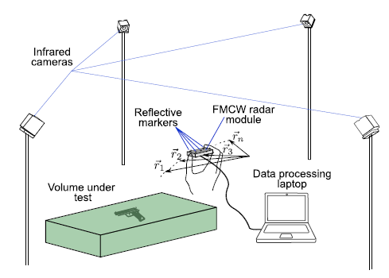
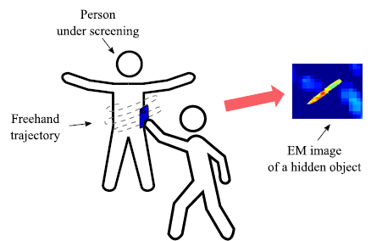
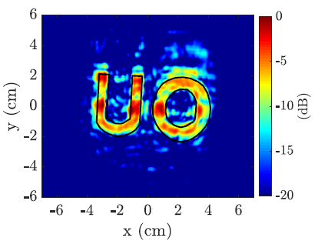
Prior Work
IR multi-camera tracking [1]
Synchronized with radar for positioning
Radar moved by hand (freehand)
Back projection algorithm (BPA)
Stereo camera + IMU tracking [2]
Smart-phone freehand imaging
Back projection algorithm (BPA)

Slide 4
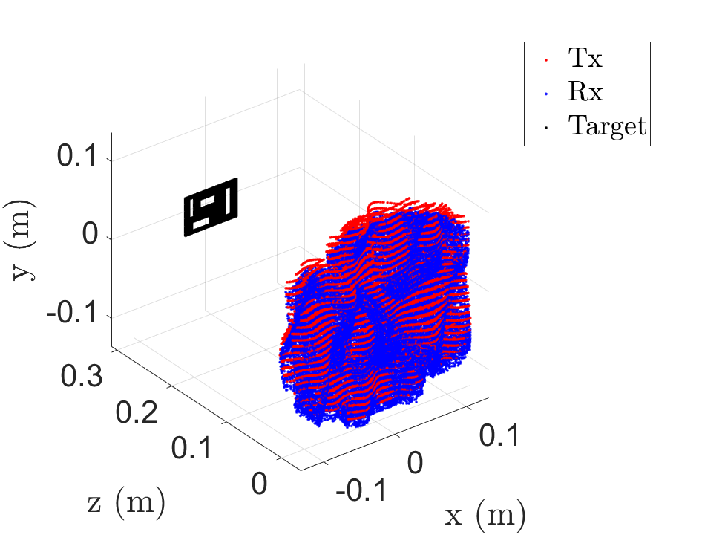
Motivation
Smart phone imaging, drone SAR, automotive SAR, IoT applications require efficient algorithms and irregular scanning
Improve image reconstruction algorithm efficiency
Irregular 3-D sampling = flexible
MIMO-SAR = faster scanning

Slide 5
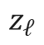
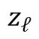
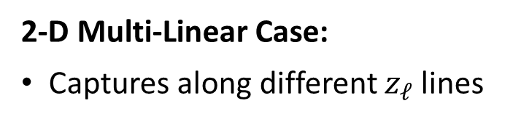
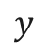
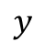
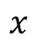
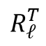
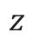
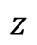
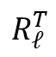
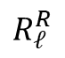
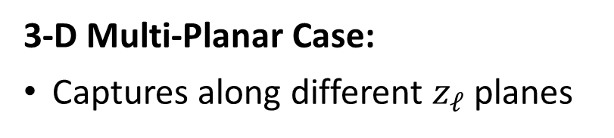
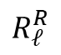
Multi-Planar Array Concept
2-D Multi-Linear Case:
Captures along different $z_{ℓ}$ lines
3-D Multi-Planar Case:
Captures along different $z_{ℓ}$ planes
$$y$$
$$y$$
Tx
Tx
Rx
Rx
$$x$$
$$R_{ℓ}^{R}$$
Target
$$R_{ℓ}^{R}$$
$$R_{ℓ}^{T}$$
$$R_{ℓ}^{T}$$
Target
$$z_{ℓ}$$
$$z$$
$$z_{ℓ}$$
$$z$$

Slide 6
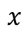
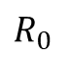
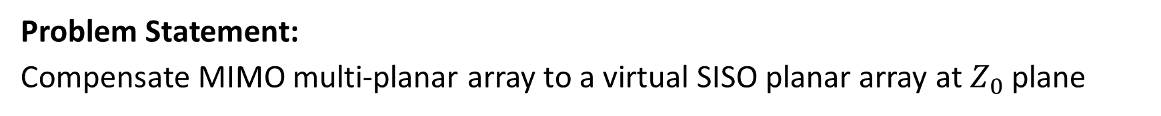
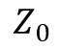
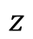
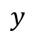
Virtual Multi-Planar Array Compensation
Problem Statement:
Compensate MIMO multi-planar array to a virtual SISO planar array at $Z_{0}$ plane
$$y$$
Tx
Rx
$$x$$
$$R_{0}$$
Target
$$Z_{0}$$
$$z$$

Slide 7
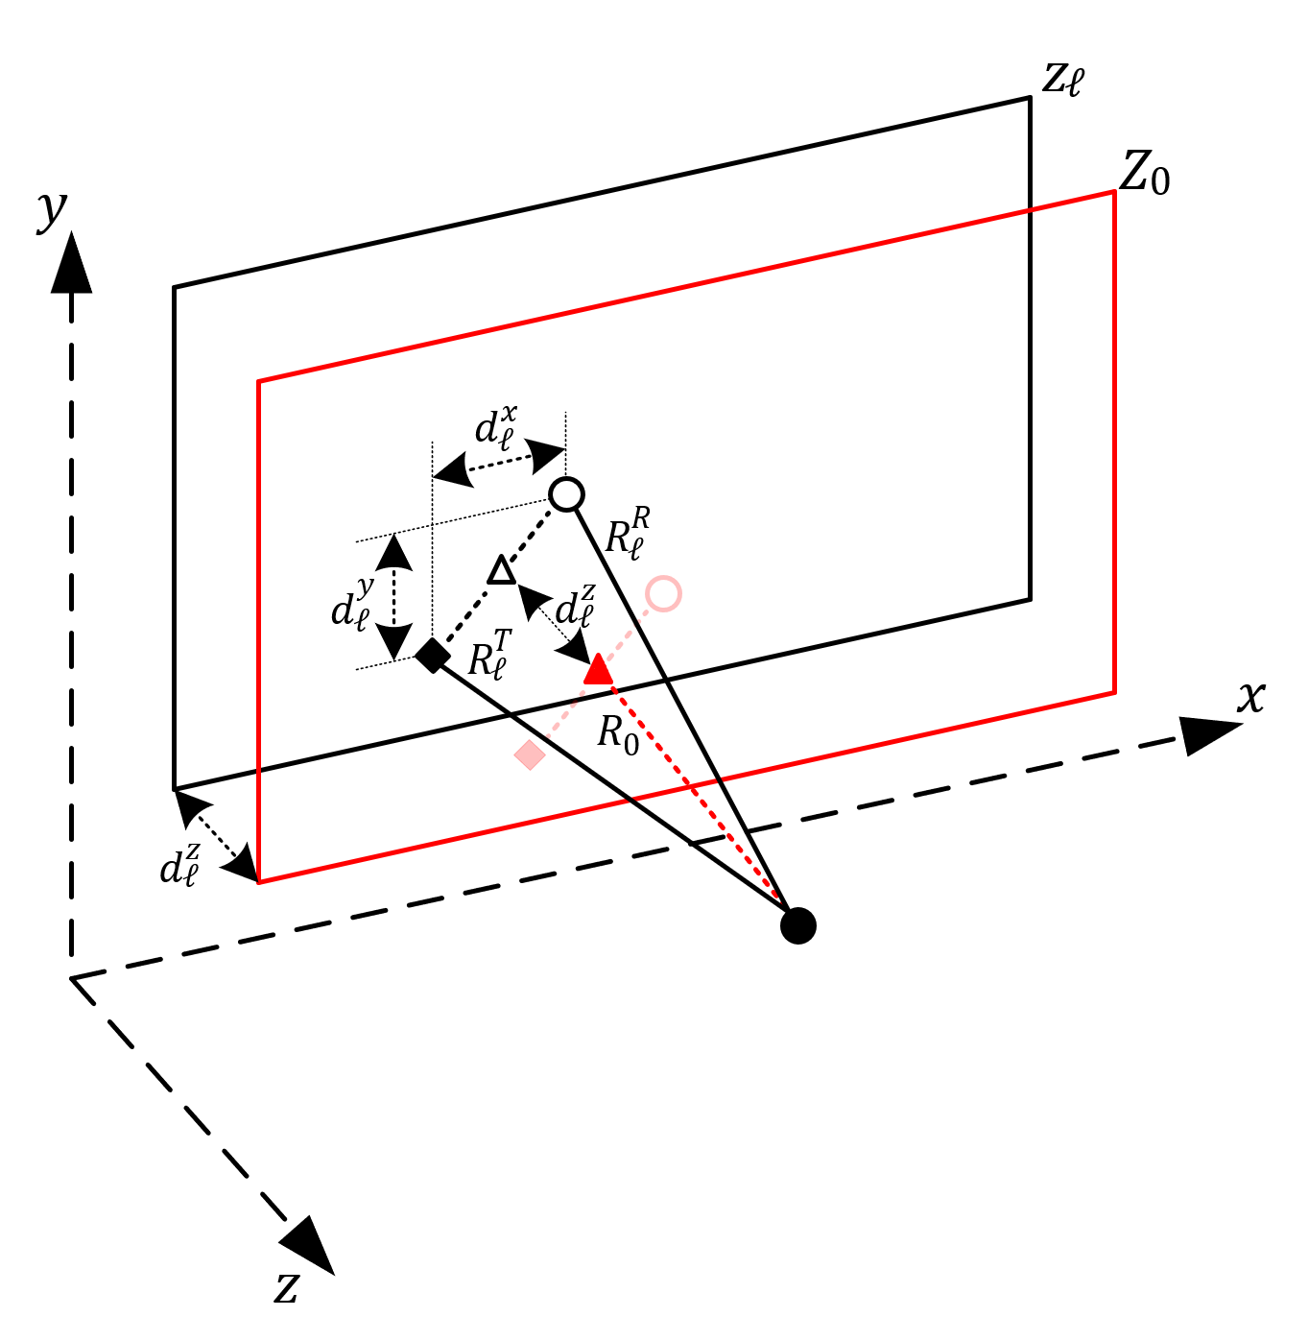
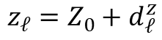
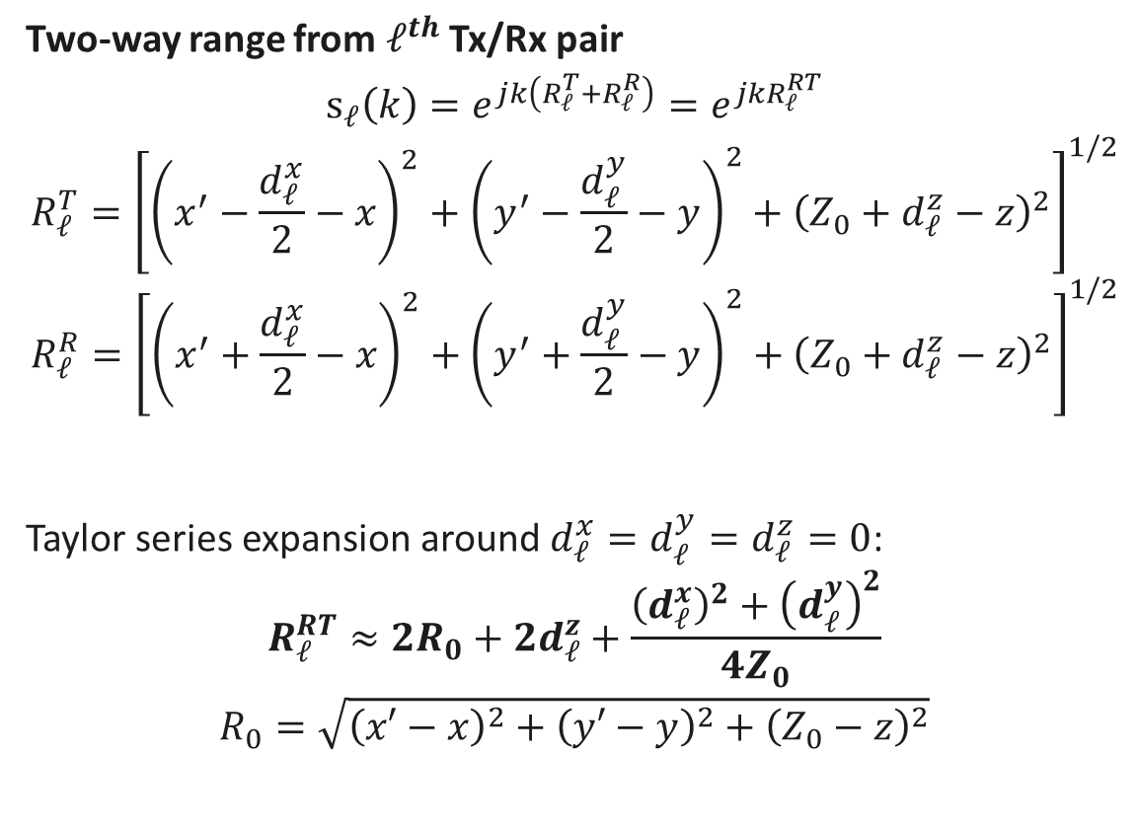
Signal Model
Two-way range from $ℓ^{th}$ Tx/Rx pair
$$s_{ℓ}\left(k\right)=e^{jk\left(R_{ℓ}^{T}+R_{ℓ}^{R}\right)}=e^{jkR_{ℓ}^{RT}}$$
$$R_{ℓ}^{T}={\left[{\left(x^{′}−\frac{d_{ℓ}^{x}}{2}−x\right)}^{2}+{\left(y^{′}−\frac{d_{ℓ}^{y}}{2}−y\right)}^{2}+{\left(Z_{0}+d_{ℓ}^{z}−z\right)}^{2}\right]}^{1/2}$$
$$R_{ℓ}^{R}={\left[{\left(x^{′}+\frac{d_{ℓ}^{x}}{2}−x\right)}^{2}+{\left(y^{′}+\frac{d_{ℓ}^{y}}{2}−y\right)}^{2}+{\left(Z_{0}+d_{ℓ}^{z}−z\right)}^{2}\right]}^{1/2}$$
Taylor series expansion around $d_{ℓ}^{x}=d_{ℓ}^{y}=d_{ℓ}^{z}=0$:
$$R_{ℓ}^{RT}≈2R_{0}+{2d}_{ℓ}^{z}+\frac{{\left(d_{ℓ}^{x}\right)}^{2}+{\left(d_{ℓ}^{y}\right)}^{2}}{4Z_{0}}$$
$$R_{0}=\sqrt{{\left(x′−x\right)}^{2}+{\left(y′−y\right)}^{2}+{\left(Z_{0}−z\right)}^{2}}$$
Tx
Rx
$$z_{ℓ}=Z_{0}+d_{ℓ}^{z}$$

Slide 8
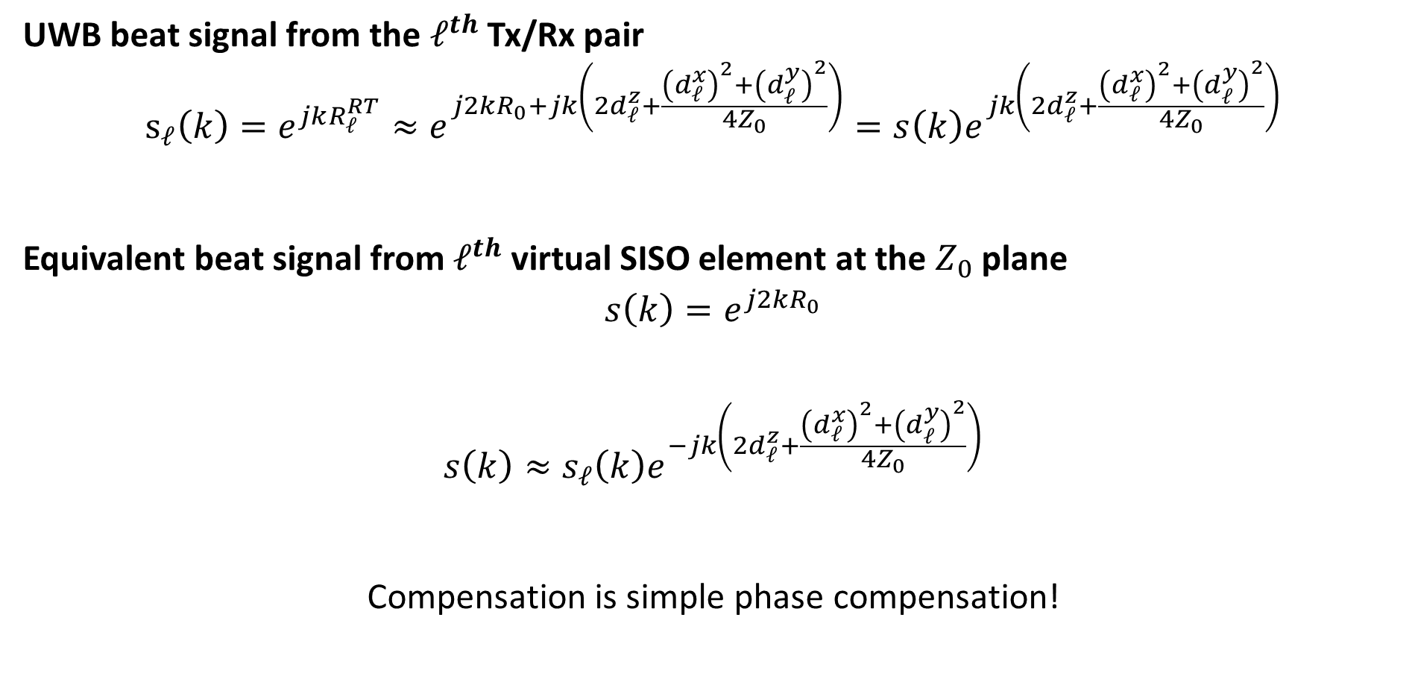
Signal Model (cont.)
UWB beat signal from the $ℓ^{th}$ Tx/Rx pair
$$s_{ℓ}\left(k\right)=e^{jkR_{ℓ}^{RT}}≈e^{j2kR_{0}+jk\left(2d_{ℓ}^{z}+\frac{{\left(d_{ℓ}^{x}\right)}^{2}+{\left(d_{ℓ}^{y}\right)}^{2}}{4Z_{0}}\right)}=s\left(k\right)e^{jk\left(2d_{ℓ}^{z}+\frac{{\left(d_{ℓ}^{x}\right)}^{2}+{\left(d_{ℓ}^{y}\right)}^{2}}{4Z_{0}}\right)}$$
Equivalent beat signal from $ℓ^{th}$ virtual SISO element at the $Z_{0}$ plane
$$s\left(k\right)=e^{j2kR_{0}}$$
$$s\left(k\right)≈s_{ℓ}\left(k\right)e^{−jk\left(2d_{ℓ}^{z}+\frac{{\left(d_{ℓ}^{x}\right)}^{2}+{\left(d_{ℓ}^{y}\right)}^{2}}{4Z_{0}}\right)}$$
Compensation is simple phase compensation!

Slide 9
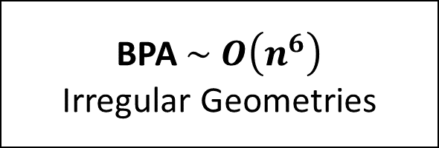

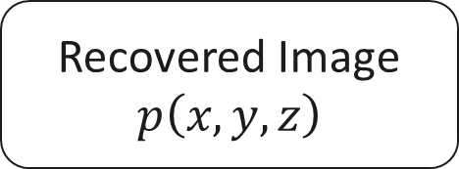

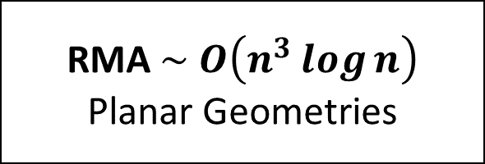
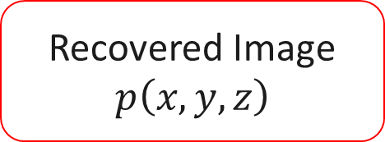

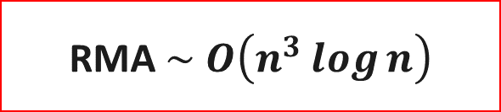

Algorithm Comparison
$$s_{ℓ}\left(k\right)$$
$$s_{ℓ}\left(k\right)$$
$$s_{ℓ}\left(k\right)$$
Phase Compensation
Multi-Planar → Planar
BPA $\sim O\left(n^{6}\right)$
Irregular Geometries
RMA $\sim O\left(n^{3}\log{n}\right)$
Planar Geometries
RMA $\sim O\left(n^{3}\log{n}\right)$
Recovered Image
$$p\left(x,y,z\right)$$
Recovered Image
$$p\left(x,y,z\right)$$
Recovered Image
$$p\left(x,y,z\right)$$

Slide 10
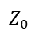
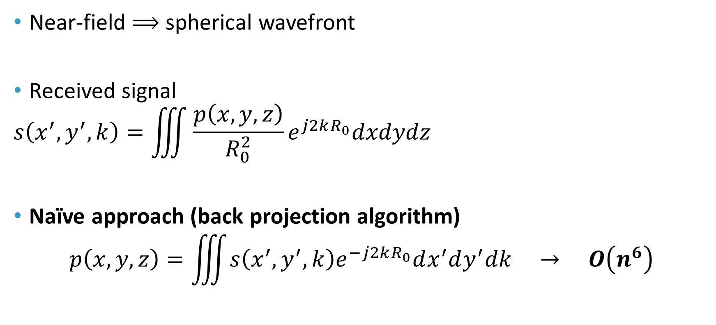
Efficient Near-Field Imaging
Near-field $⟹$ spherical wavefront
Received signal
$$s\left(x^{′},y^{′},k\right)=\iiint{\frac{p\left(x,y,z\right)}{R_{0}^{2}}}e^{j2kR_{0}}dxdydz$$
Naïve approach (back projection algorithm)
$$p\left(x,y,z\right)=\iiint{s\left(x^{′},y^{′},k\right)e^{−j2kR_{0}}dx^{′}dy^{′}dk} → O\left(n^{6}\right)$$
Target
y
Tx/Rx
z
$$Z_{0}$$

Slide 11

Efficient Near-Field Imaging
Near-field $⟹$ spherical wavefront
Received signal
$$s\left(x^{′},y^{′},k\right)=\iiint{\frac{p\left(x,y,z\right)}{R_{0}^{2}}}e^{j2kR_{0}}dxdydz$$
Efficient approach – key step
$$\frac{e^{j2kR_{0}}}{R_{0}}≈\iint{\frac{e^{j\left(k_{x}\left(x^{′}−x\right)+k_{y}\left(y^{′}−y\right)+k_{z}Z_{0}\right)}}{k_{z}}dk_{x}dk_{y}}$$
Target
y
Tx/Rx
z
$$Z_{0}$$

Slide 12
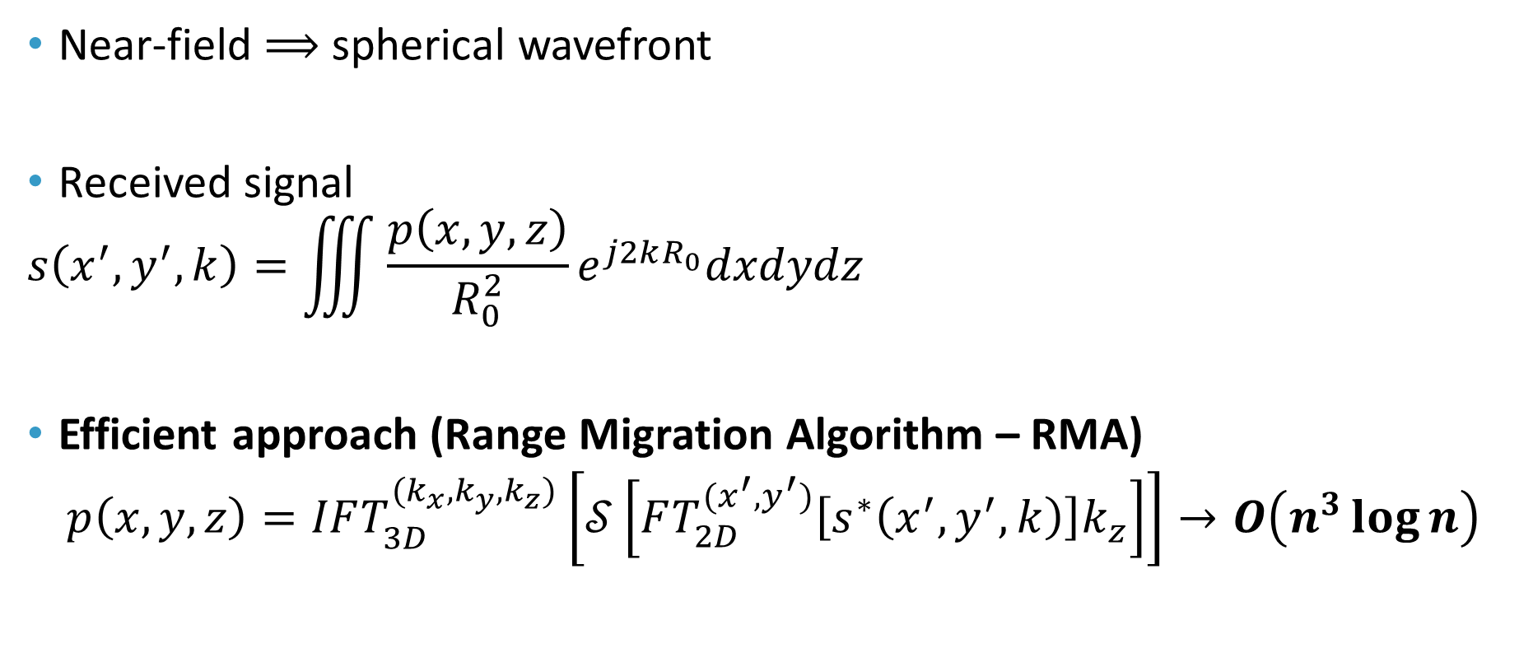
Efficient Near-Field Imaging
Near-field $⟹$ spherical wavefront
Received signal
$$s\left(x^{′},y^{′},k\right)=\iiint{\frac{p\left(x,y,z\right)}{R_{0}^{2}}}e^{j2kR_{0}}dxdydz$$
Efficient approach (Range Migration Algorithm – RMA)
$$p\left(x,y,z\right)=IFT_{3D}^{{(k}_{x},k_{y},k_{z})}\left[𝒮\left[FT_{2D}^{{(x}^{′},y^{′})}\left[s^{∗}\left(x^{′},y^{′},k\right)\right]k_{z}\right]\right]→O\left(n^{3}\log{n}\right)$$
Target
y
Tx/Rx
z
$$Z_{0}$$
Assumes co-planar data

Slide 13
Algorithm Comparison
$$s_{ℓ}\left(k\right)$$
$$s_{ℓ}\left(k\right)$$
$$s_{ℓ}\left(k\right)$$
Phase Compensation
Multi-Planar → Planar
BPA $\sim O\left(n^{6}\right)$
Irregular Geometries
RMA $\sim O\left(n^{3}\log{n}\right)$
Planar Geometries
RMA $\sim O\left(n^{3}\log{n}\right)$
Recovered Image
$$p\left(x,y,z\right)$$
Recovered Image
$$p\left(x,y,z\right)$$
Recovered Image
$$p\left(x,y,z\right)$$

Slide 14
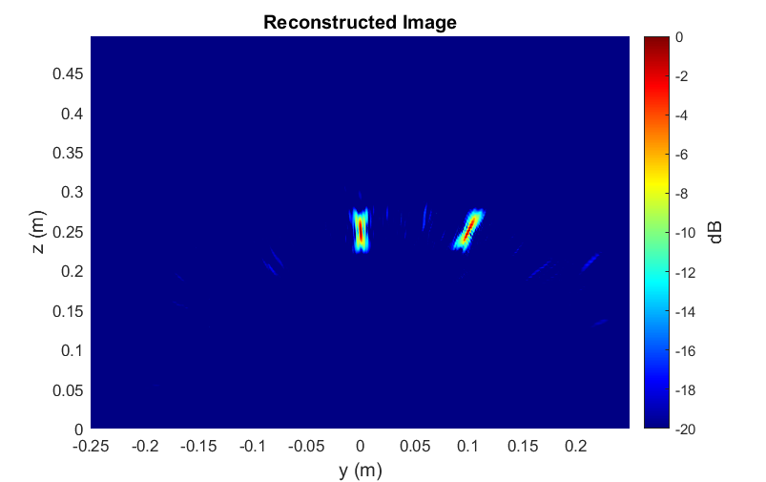
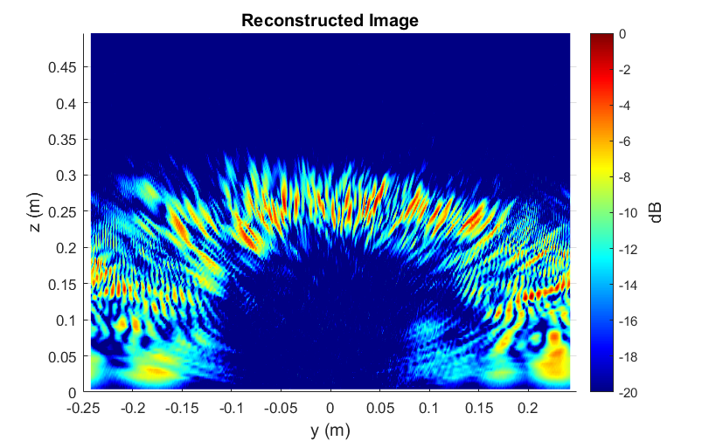
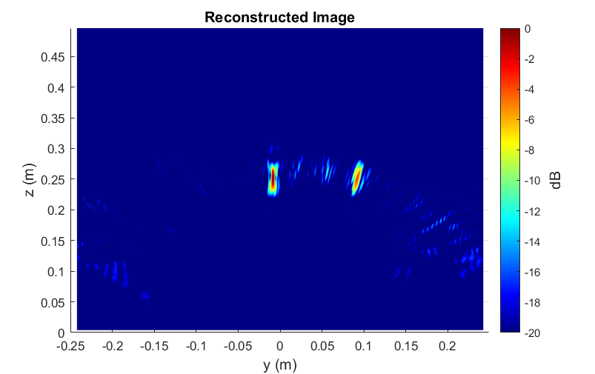
Simulation Results: Multi-Linear Random
Multi-Linear Array Point Targets
Antenna perturbance: Gaussian
BPA – 5 mins
RMA – 30 ms
Ours – 30 ms

Slide 15
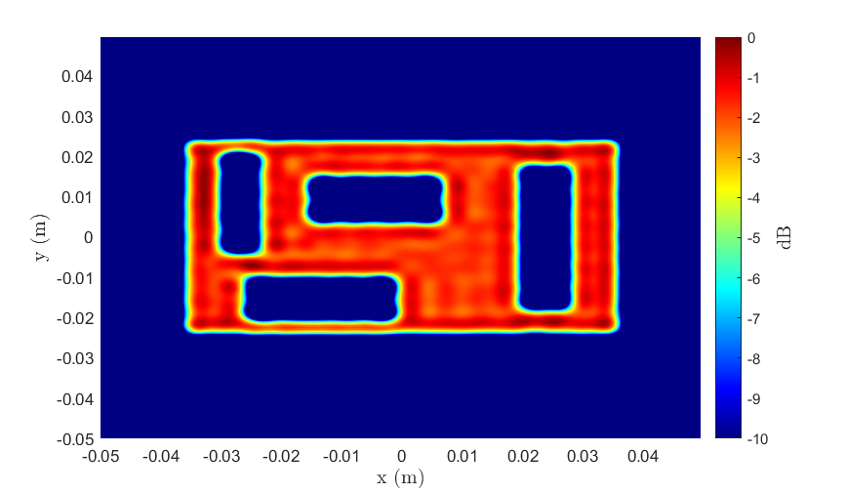
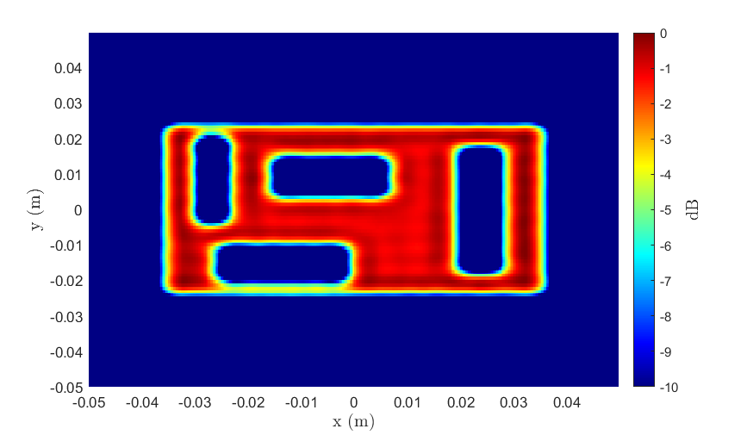
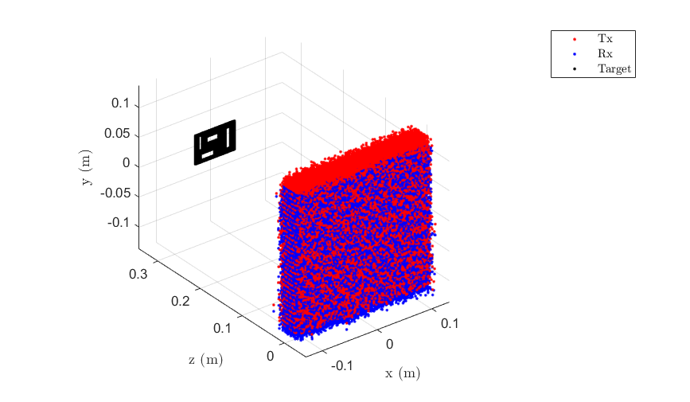
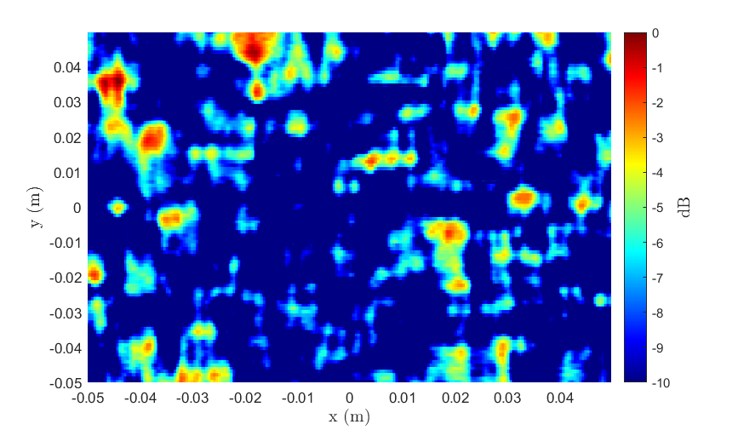
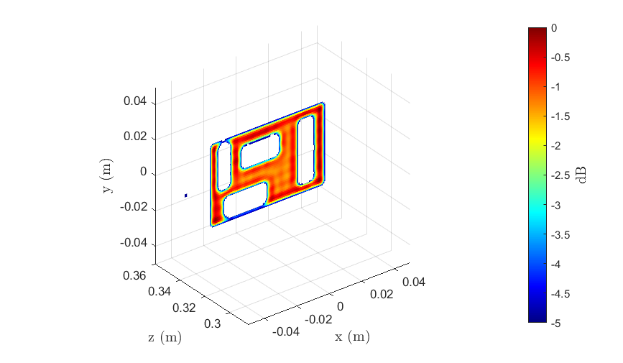
Simulation Results: Multi-Planar Random
Multi-Planar Array Cutout
Antenna perturbance: Gaussian
2-D BPA – 3 hrs
3-D BPA – 150 hrs
Ours – 1 s
RMA – 1 s
Ours – 14 s

Slide 16
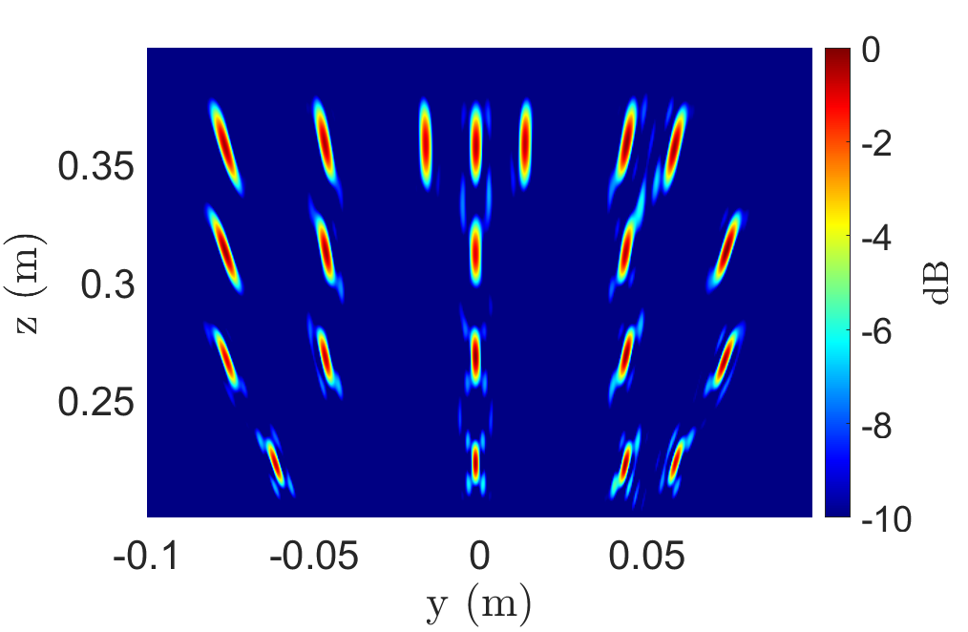
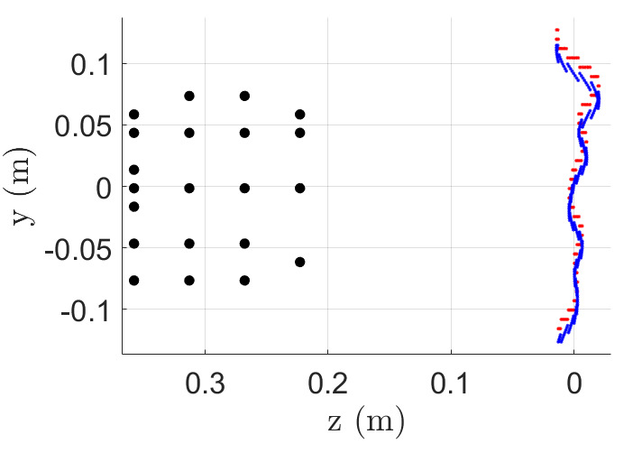


Simulation Results: Multi-Linear Freehand
Multi-Linear Array Point Targets
BPA – 5 mins
Antenna perturbance: freehand motion
RMA – 30 ms
Ours – 30 ms

Slide 17




Simulation Results: Multi-Planar Freehand
Multi-Planar Array Cutout
2-D BPA – 3 hrs
3-D BPA – 150 hrs
Ours – 1 s
Antenna perturbance: freehand motion
RMA – 1 s
Ours – 5 s

Slide 18



System Design
Perform multiple planar scans with the target at different $z_{ℓ}$ planes
Sample from different scans to emulate non-cooperative geometry
Take samples from random $z_{ℓ}$ plane
Non-cooperative scanning patterns are typically considered infeasible due to computational expense
Compare algorithm performance
Computational complexity
Image quality

Slide 19




Empirical Data Collection
Multiple x-y scans of same target at multiple $z_{ℓ}$-planes
Dense Sampling
Irregular Scanning Geometry

Slide 20




Experiment 1: Metal Cutout
Multi-Planar Array
Cutout
BPA – 3 hr
Antenna perturbance: freehand motion
RMA – 1 s
Ours – 1 s

Slide 21





Experiment 2: Hidden Tools
Tools hidden inside cardboard box
Ours – 4 s
BPA – 10 hr
Ours – 11 s
BPA – 400 hr

Slide 22





Experiment 3: Suspicious Bag
Metal items hidden inside leather purse
Ours – 4 s
BPA – 10 hr
Ours – 11 s
BPA – 400 hr

Slide 23
Conclusions and Summary
Imaging with irregular scanning geometries
Efficient computation for mobile devices, IoT, and edge applications
BPA image quality with RMA efficiency
 | BPA | RMA | Ours
Computational Complexity | Intractable | Acceptable | Acceptable
Image Quality | Acceptable | Unacceptable | Acceptable
Sample Image

Slide 24



Potential Directions and Future Work
Developing freehand imaging system
mmWave radar + stereo camera
Extend to automotive or drone imaging with large cascade MIMO radar
Sensor fusion, radar + camera, for improved 3-D imaging
Publication coming on algorithm

Slide 25

Questions?

